Slide 1

CAP 6317/4773: Social Media Mining
Lecture 14: Data Mining and Project Guidelines
Raiyan Abdul Baten, Ph.D.
February 27, 2024

Slide 2
Recap

Slide 3
Since the
last quiz
Network Models
Random graphs
Small world graphs
Preferential attachment graphs
Statistics
Confidence intervals
Correlation coefficient
Chi Squared test
Hypothesis testing: simple and factorial design
Randomized Controlled Experiments
Machine Learning
Regression

Slide 4
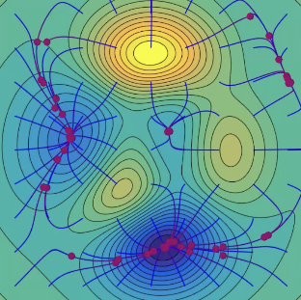

Simple Linear Regression
Let w = [w₀ , w₁ ]^{T}
In our case, we want to find w such that the function RSS(w) is minimized.
At step t, we have estimates of w₀^{(t)} and w₁^{(t)}, denoted as w^{(t)}.
In the next step t+1, we want updated estimates w^{(t+1)} so that we’re moving towards the minima of RSS(w^{(t)}). We know that RSS(w^{(t)}) decreases the fastest if we go from w^{(t)} in the direction of the negative gradient of RSS(w^{(t)}).
w^{(t+1)} = w^{(t)} - ∇ RSS(w^{(t)})
w₁
w₀

Slide 5


Multi-Regression: Multiple features
Regression model:
The residual sum of squares, RSS, is:
The above is a generalization of our previous RSS:

Slide 6
Multi-Regression: Multiple features
Alternatively, use Gradient Descent:
At t = 1, initialize w⁽¹⁾ = 0 or randomly or smartly
while |∇RSS(w^{(t)})| > threshold:

Slide 7
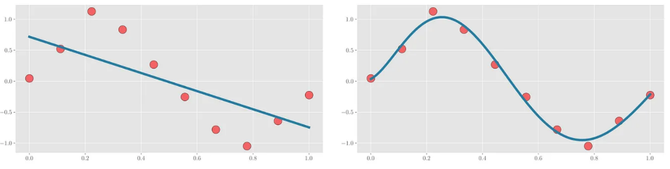
Polynomial Regression

Slide 8
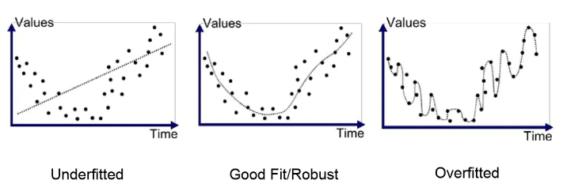

Ridge Regression
When your curve is overfitting (memorizing the datapoints), the curve needs to change steeply, and the coefficient values become large

Slide 9
Ridge Regression
Total cost = measure of fit (RSS) + measure of the magnitude of coefficients
Total cost = RSS(w) + λ ( )
Total cost = RSS(w) + λ w^{T}w

Slide 10
LASSO Regression
Total cost = measure of fit (RSS) + measure of the magnitude of coefficients
Total cost = RSS(w) + λ ( )

Slide 11
ElasticNet Regression
Total cost = measure of fit (RSS) + measure of the magnitude of coefficients
Total cost = RSS(w) + λ₁ ( ) + λ₂ ( )

Slide 12
Regression Modeling
Linear regression – Ridge
Linear regression – LASSO
ElasticNet regression
Bayesian regression
Support Vector regression
Random Forest
AdaBoost
XGBoost

Slide 13
Questions?

Slide 14
Pop Quiz

Slide 15
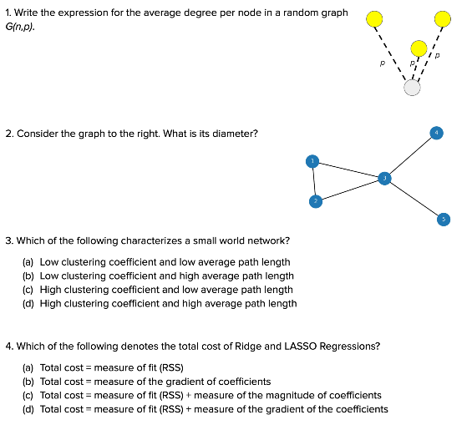

Slide 16
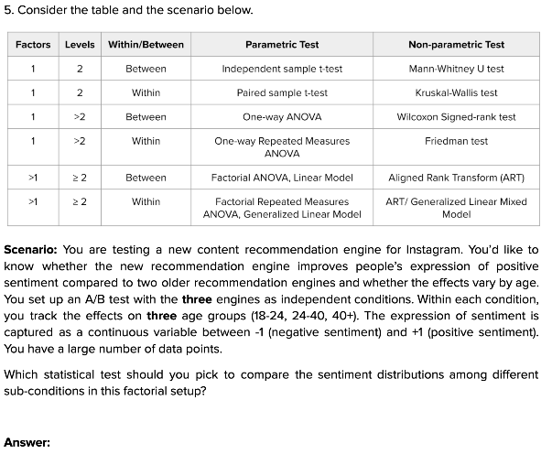

Slide 17
Reminder to self: Attendance

Slide 18
Group Project

Slide 19
The projects listed in your CV are the conversation starters in any interview

Slide 20
The projects listed in your CV are the conversation starters in any interview
Open ended project: Be creative!
Guidelines and examples provided below
I can help you craft a project if you struggle to define one

Slide 21
Group Formation
40 graduate students
8 teams of 5 members each

Slide 22
Group Formation
40 graduate students
8 teams of 5 members each
17 undergraduate students
3 teams (2 teams of 6 and 1 team of 5)
(We can also do 4 teams (3 teams of 4 and 1 team of 5) if needed)

Slide 23
Group Formation
40 graduate students
8 teams of 5 members each
17 undergraduate students
3 teams (2 teams of 6 and 1 team of 5)
(We can also do 4 teams (3 teams of 4 and 1 team of 5) if needed)
Please let me know the groups by Friday midnight
I will assign group numbers randomly

Slide 24
Deliverables and Timeline
Week 11 | 3/19 | Project Proposal Presentation (Groups 1-6); slides due at midnight
 | 3/21 | Project Proposal Presentation (Groups 7-12); slides due at midnight
Week 15 | 4/16 | Final Presentations (Groups 1, 2, 3); slides due at midnight
 | 4/18 | Final Presentations (Groups 4, 5, 6); slides due at midnight
Test free week (4/20 - 4/26) | 4/23 | Final Presentations (Groups 7, 8, 9); slides due at midnight
 | 4/25 | Final Presentations (Groups 10, 11, 12); slides due at midnight
Exams week (4/27 - 5/2) | 4/29 | Final Project Report due (9 am on Mon, April 29, 2024)

Slide 25
Grading
40% of final grade
30% common + 10% individual
 | Common grade | Individual grade
Project Proposal Presentation | 10% | -
Final Presentation | 10% | 5%
Written Report | 10% | 5%

Slide 26
Guidelines
The project needs to have a set of Research Questions (RQs)
What are you probing? Why is it important?
RQs need to be relevant to this course

Slide 27
Guidelines
The project needs to have a set of Research Questions (RQs)
What are you probing? Why is it important?
RQs need to be relevant to this course
It can be part of your ongoing research project
But it needs to have a well-defined end goal

Slide 28
Guidelines
The project needs to have a set of Research Questions (RQs)
What are you probing? Why is it important?
RQs need to be relevant to this course
It can be part of your ongoing research project
But it needs to have a well-defined end goal
You are free to use any language/library/method you want
Use of AI is permitted: Build something ChatGPT cannot!

Slide 29
Guidelines
The project needs to have a set of Research Questions (RQs)
What are you probing? Why is it important?
RQs need to be relevant to this course
It can be part of your ongoing research project
But it needs to have a well-defined end goal
You are free to use any language/library/method you want
Use of AI is permitted: Build something ChatGPT cannot!
You can use existing datasets or collect new data
The research questions and data need to be from either
Social Media sources (network/non-network data)
Non-Social Media sources with social network component
Simulated/synthetic data

Slide 30












We are interested in ‘social’ + ‘media’ data
Information exchanged via contacts
Teams interact virtually
Editors interact to curate content
Collaborate on a project, ‘star’ others’ projects
Write papers together, cite others’ papers

Slide 31
Social Science
Network/computational Science
Social Media Mining
Statistics and Data Mining

Slide 32
Social Science
Network/computational Science
Social Media Mining
You can use network-based methods (everything we’ve covered and beyond)
Statistics and Data Mining

Slide 33
Social Science
Network/computational Science
Social Media Mining
You can use non-network methods like statistics and data mining (ML/NLP/CV), including deep learning
Statistics and Data Mining

Slide 34
Social Science
Network/computational Science
Social Media Mining
We will soon look at network-based ML, Recommendation engines. We will also cover user modeling applications
Statistics and Data Mining

Slide 35
Social Science
Network/computational Science
Social Media Mining
We have already looked at some social science results. We will soon look at more (community behavior, influence, information diffusion)
Statistics and Data Mining

Slide 36
Social Science
Network/computational Science
Have fun!
Social Media Mining
Statistics and Data Mining

Slide 37
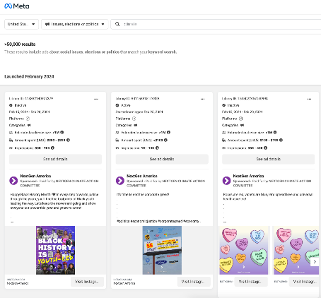
Example Projects for Inspiration
Ad microtargeting on Facebook
RQ: Can the stance and topic of political ads be automatically detected? What are the microtargeting patterns of political ads running on facebook?
Dataset: Meta Ad Library

Slide 38
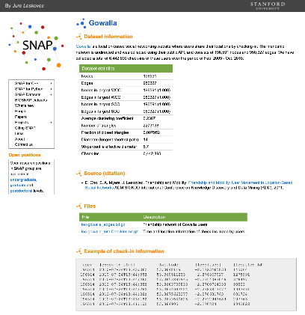
Example Projects for Inspiration
User modeling: Location prediction
RQ: Can we predict the location (check-in) of a given user at a specific future time?
Dataset: SNAP datasets

Slide 39
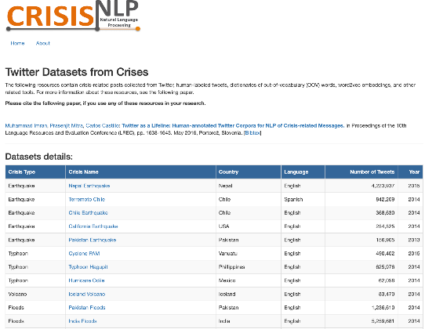
Example Projects for Inspiration
Ebola and MERS outbreak classification from Tweets
RQ: Can we sense disease outbreaks automatically by mining social media data?
Dataset: Crisis NLP

Slide 40

Example Projects for Inspiration
Community behavior mining from Yelp
RQ: Can we predict the rating of a business on Yelp? Can we classify what category a business belongs to?
Dataset: Yelp

Slide 41
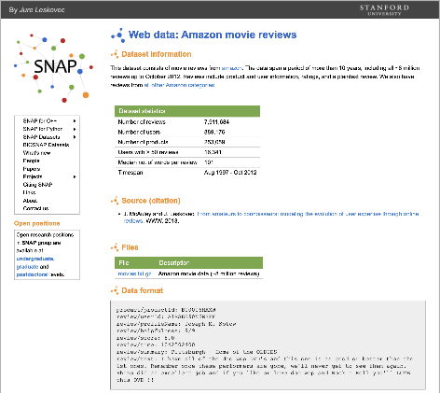
Example Projects for Inspiration
User modeling: Reviewer expertise evolution
RQ: Can we model the expertise of reviewers over time?
Dataset: SNAP datasets

Slide 42
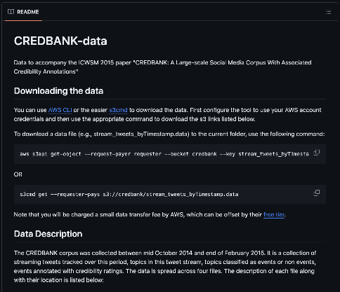
Example Projects for Inspiration
Credibility assessment on social media
RQ: Can we predict whether a Tweet is trustworthy?
Dataset: CREDBANK

Slide 43
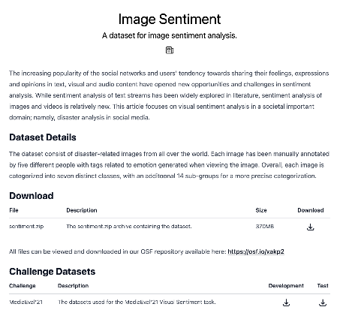
Example Projects for Inspiration
Multimodal sentiment analysis
RQ: Can we estimate the sentiment of social media posts using texts? Using images? Using both?
Dataset: Image sentiment data

Slide 44
Example Projects for Inspiration
Damage assessment from social media imagery data during disasters
RQ: Can we sense disaster damage automatically by mining social media data?
Dataset: Crisis NLP

Slide 45
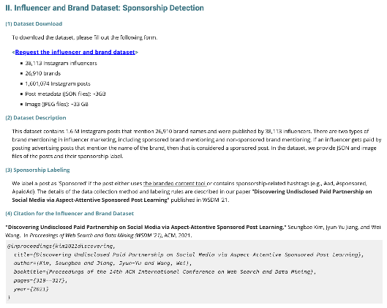
Example Projects for Inspiration
Influencer modeling
RQ: Can we automatically identify the influencers on Instagram? Can we find undisclosed paid partnerships on social media?
Dataset: Dr. Kim's Lab

Slide 46
Example Topics
Health and wellbeing
Mental health
Physical health, vaping
Covid-19, disease tracking
Bullying

Slide 47
Example Topics
Human behavior/user modeling
Sentiment analysis, temporal trends
Test social balance from sentiment
Location prediction
Location-based sentiment (geography of happiness)
User clustering based on geographic data
Amazon reviewer modeling
Credibility modeling

Slide 48
Example Topics
Non-human entity modeling
Predict the popularity of movies (Tweet data, box office data, Wikipedia page view data)
Yelp review prediction
Amazon product ranking
Popularity of online content
Natural disaster understanding/sensing from social media

Slide 49
Example Topics
Behavior propagation through social networks
Exercise - Strava API
Spending habits (venmo)
Food habits (Credit card – purchasing category data)

Slide 50
Example Topics
Information propagation
Rumor cascade
Misinformation origin detection, propagation sensing

Slide 51
Example Topics
Community behavior patterns
Social movements
Climate change discourse
Polarization on social media

Slide 52
Example Topics
Influence on Social Media
Influencer detection (with and without network data): e.g., use sports hashtags to find sports influencers
Measuring celebrity influence on Twitter

Slide 53

Observatory on Social Media

Slide 54
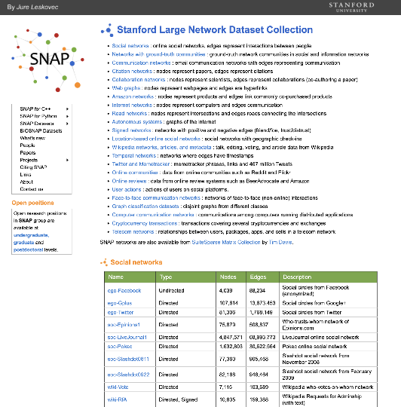
Stanford Large Datasets

Slide 55
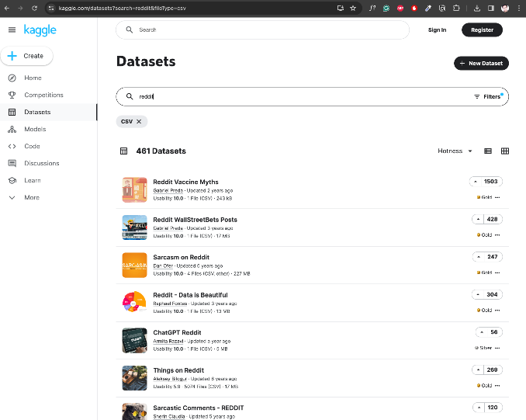
Kaggle Datasets

Slide 56
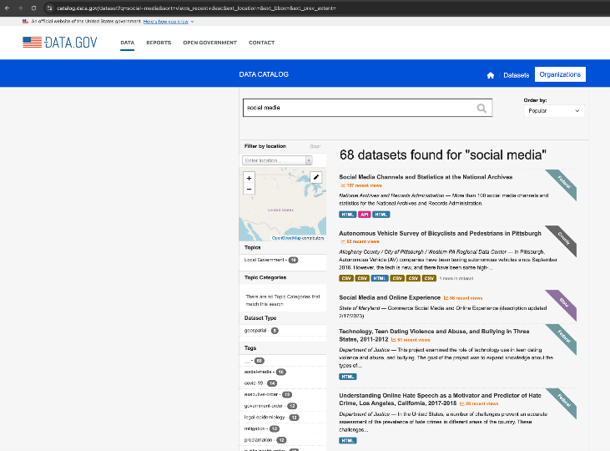
data.gov

Slide 57
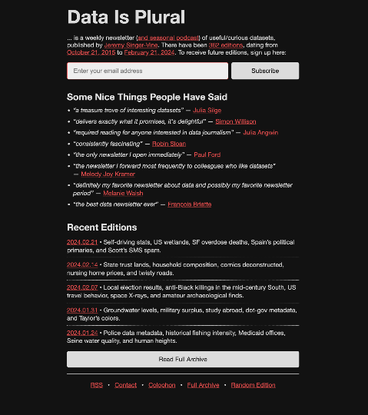
Data is Plural
(spreadsheet)

Slide 58
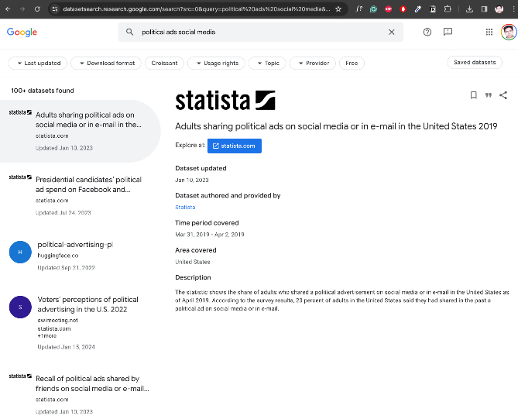
Google Dataset Search

Slide 59
Week 11 | 3/19 | Project Proposal Presentation (Groups 1-6); slides due at midnight
 | 3/21 | Project Proposal Presentation (Groups 7-12); slides due at midnight
Project Proposal Presentation
 | Common grade | Individual grade
Project Proposal Presentation | 10% | -
Each team gets 8 minutes to present their proposal
Must include the following items (2% common grade weight in each):
Motivation
Related Work
Research Question(s)
Data
Method

Slide 60
Project Proposal Presentation
Motivation
What are you probing? Why is this important?

Slide 61
Project Proposal Presentation
Motivation
What are you probing? Why is this important?
Related Work
Describe at least one relevant work in literature. Explain how your work is different than theirs.

Slide 62
Project Proposal Presentation
Motivation
What are you probing? Why is this important?
Related Work
Describe at least one relevant work in literature. Explain how your work is different than theirs.
Research Question(s)
State the research hypothesis you would like to test in this project. The hypothesis should be specific enough to be tested quantitatively by your analysis.

Slide 63
Project Proposal Presentation
Data
How will you acquire and process the data?

Slide 64
Project Proposal Presentation
Data
How will you acquire and process the data?
Method
What analysis method will you apply to answer your research questions? (Statistical testing/machine learning/ deep learning/ network scientific tools)
What software libraries will you use?

Slide 65
Week 15 | 4/16 | Final Presentations (Groups 1, 2, 3); slides due at midnight
 | 4/18 | Final Presentations (Groups 4, 5, 6); slides due at midnight
Test free week (4/20 - 4/26) | 4/23 | Final Presentations (Groups 7, 8, 9); slides due at midnight
 | 4/25 | Final Presentations (Groups 10, 11, 12); slides due at midnight
Final Presentation
 | Common grade | Individual grade
Final Presentation | 10% | 5%
Each team gets 15 minutes to present, each member must participate
Must include the following items:
Motivation and RQs (1% common grade weight)
Literature review (1% common grade weight)
Data (2% common grade weight)
Method (3% common grade weight)
Results (2% common grade weight)
Discussion (1% common grade weight)
Contribution of each team member

Slide 66
Final Presentation
Motivation and Research Question(s)
What did you probe and why?
State the specific research hypotheses you tested

Slide 67
Final Presentation
Motivation and Research Question(s)
What did you probe and why?
State the specific research hypotheses you tested
Literature Review
Briefly summarize relevant works in literature. Explain how your work is different than theirs.

Slide 68
Final Presentation
Motivation and Research Question(s)
What did you probe and why?
State the specific research hypotheses you tested
Literature Review
Briefly summarize relevant works in literature. Explain how your work is different than theirs.
Data
Where did you acquire the data from?
How exactly did you pre-process the data?

Slide 69
Final Presentation
Method
What analysis method did you use?
What software library did you use?

Slide 70
Final Presentation
Method
What analysis method did you use?
What software library did you use?
Results
Did you find support for your hypotheses? Your claims should be backed by quantitative evidence
Include figure(s) or table(s) describing your results

Slide 71
Final Presentation
Method
What analysis method did you use?
What software library did you use?
Results
Did you find support for your hypotheses? Your claims should be backed by quantitative evidence
Include figure(s) or table(s) describing your results
Discussion
Do your results agree/disagree with prior results? Do your results extend prior knowledge? Were you expecting these results? What are the limitations? What can be done next?

Slide 72
Final Presentation
Method
What analysis method did you use?
What software library did you use?
Results
Did you find support for your hypotheses? Your claims should be backed by quantitative evidence.
Include figure(s) or table(s) describing your results
Discussion
Do your results agree/disagree with prior results? Do your results extend prior knowledge? Were you expecting these results? What are the limitations? What can be done next?
Contribution of each team member

Slide 73
Final Written Report
Exams week (4/27 - 5/2) | 4/29 | Final Project Report due (9 am on Mon, April 29, 2024)
 | Common grade | Individual grade
Written Report | 10% | 5%
3-4 pages + 1 page for reference
IEEE conference format
Word, LaTeX, and Overleaf templates

Slide 74
Final Written Report
Abstract (0.5% common grade weight)
Motivation and RQs (1% common grade weight)
Literature review (0.5% common grade weight)
Data (2% common grade weight)
Method (3% common grade weight)
Results (2% common grade weight)
Discussion (0.5% common grade weight)
References (0.5% common grade weight)
Contribution of each team member
Provide sufficient details for someone to replicate your work. Include a link to a public Github repository with all your code.

Slide 75
Summary

